Slide 1

FairBid – Real-Time Fair Auction System
Team Name · 404 Crackers · HackFusion
TEAM MEMBERS: Anand · Amith · Kartik · Prashant
“Eliminating unfair advantages in online auctions through real-time intelligent bidding.”

Slide 2

Problem Statement Overview
The Problem
Online auctions are unfair due to network latency and last-second bidding. Users with faster internet gain an unfair advantage, leading to biased outcomes and loss of trust.
Domain / Category
FinTech / Real-Time Systems
Why It Matters
Millions of users participate in auctions daily, but unfair systems discourage participation, reduce transparency, and cause financial loss.

Slide 3
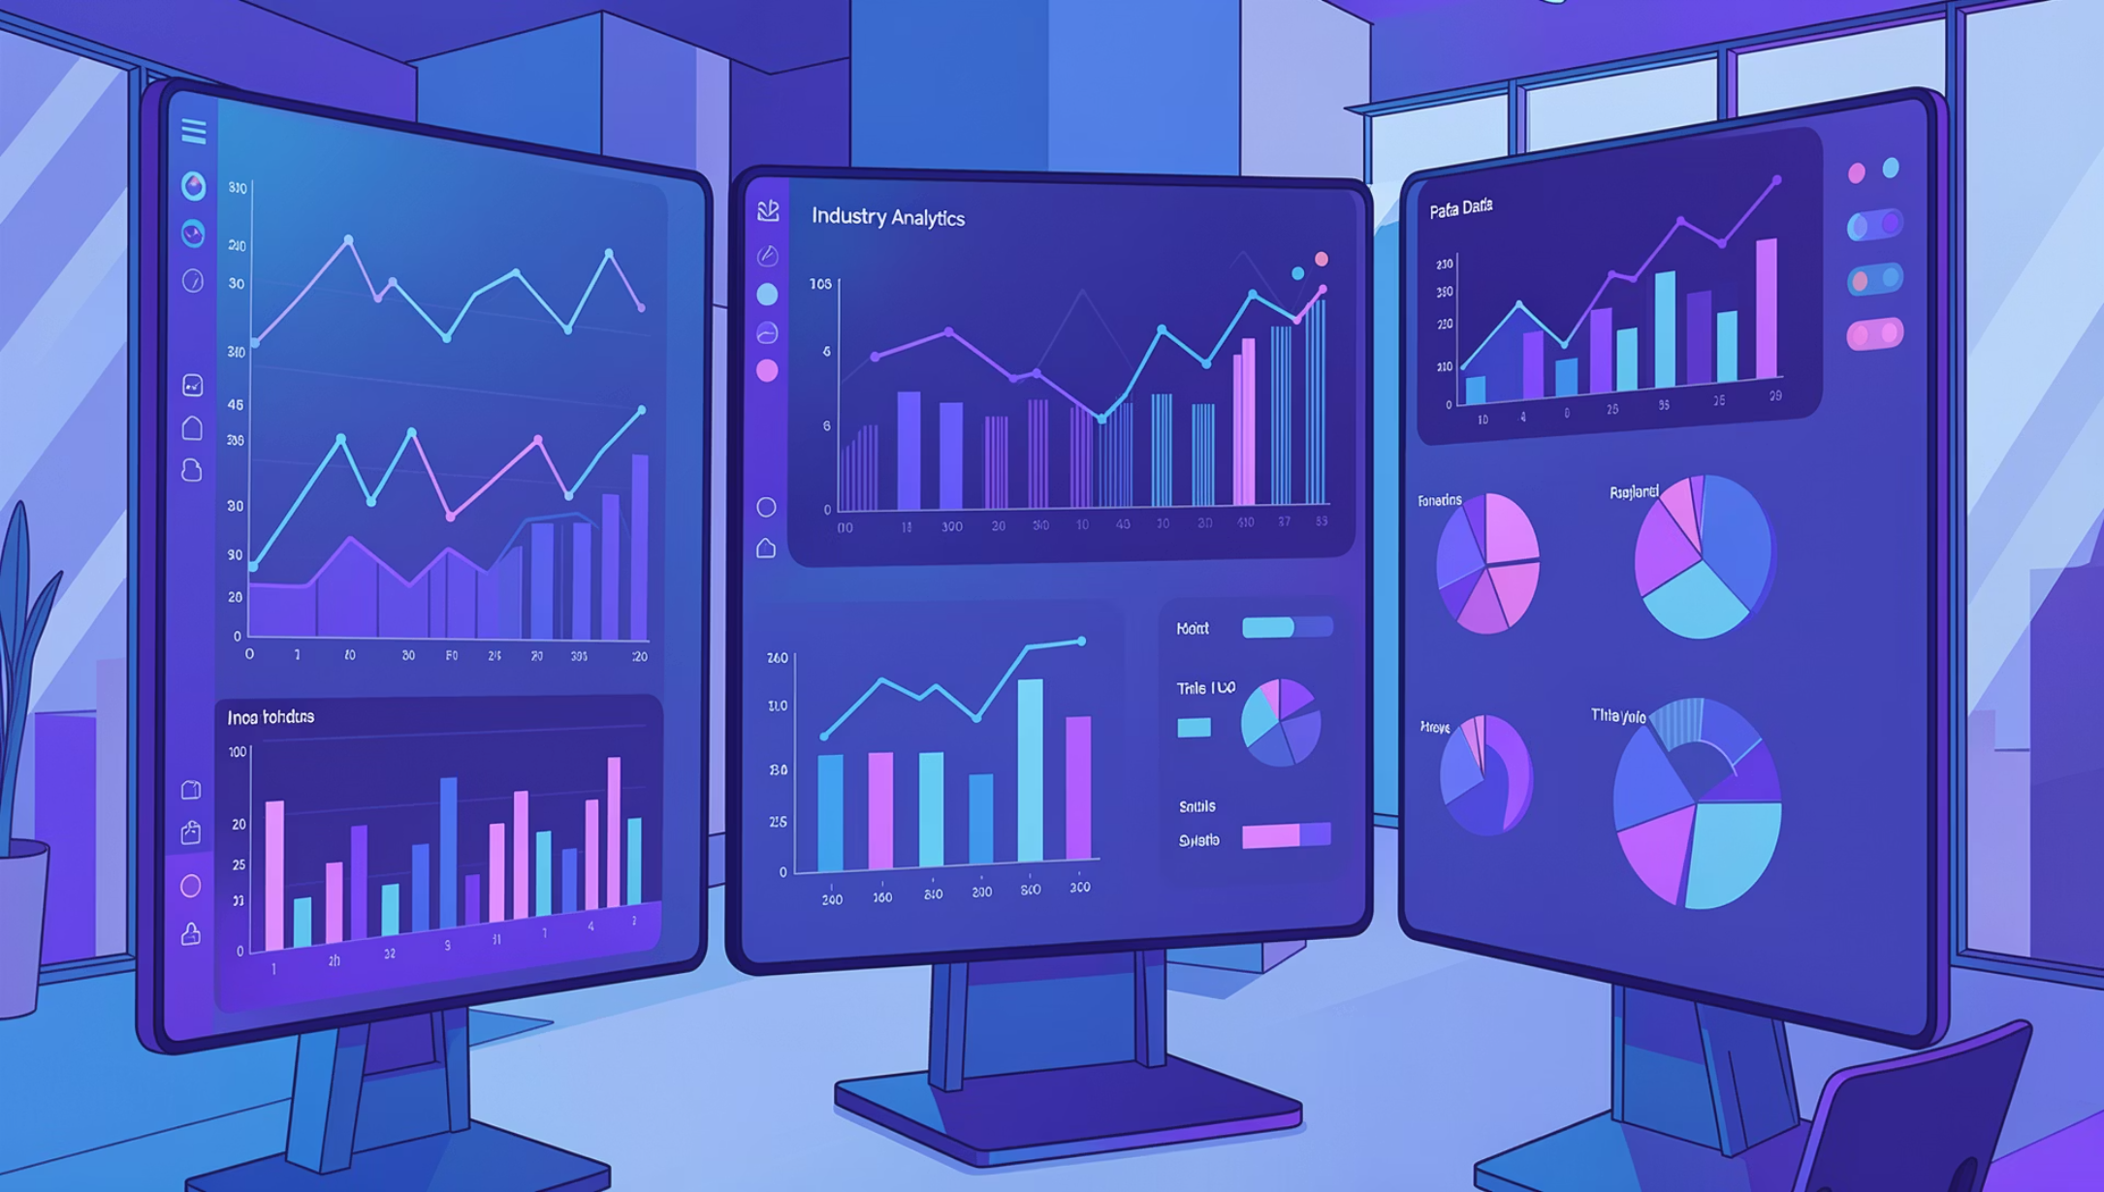
Background & Context
Current Situation
Most auction platforms:
Favor faster connections
Allow last-second “sniping”
Lack fairness mechanisms
Stat 1
Stat 2
Stat 3
70% of users affected
$5B+ market size
Crores of hrs lost/week

Slide 4
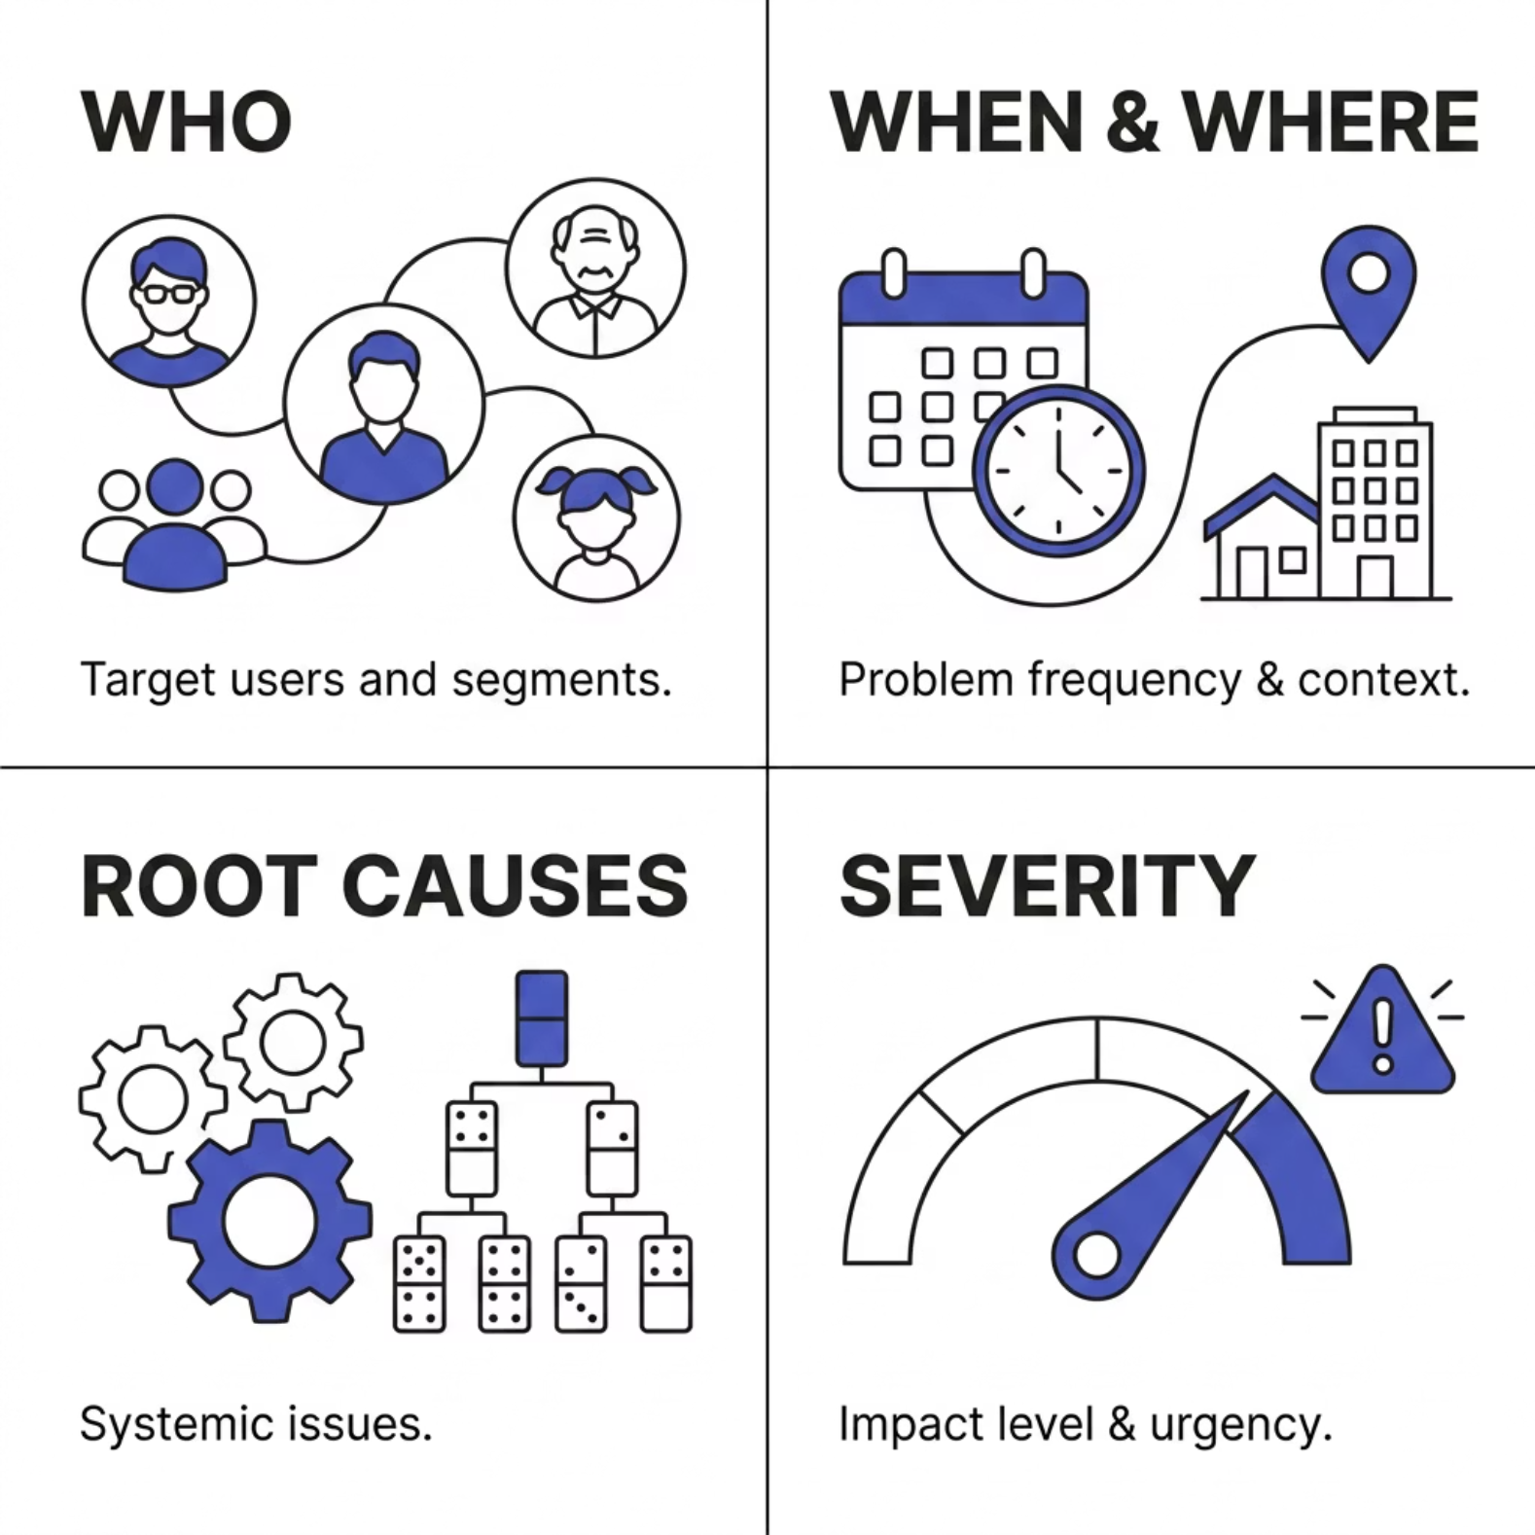

Problem Deep Dive
Unpacking the Core Issue
Data Transparency issue and other financial scams in the name of auction, bots in auction
Who : Buyers, sellers, and auction platforms
When & Where: Online real-time auctions (e-commerce, NFTs, bidding platforms)
Root Causes: Network latency differences
No server-side fairness validation
Race conditions in last-second bids

Slide 5



Target Audience & Stakeholders
Primary User
Secondary Stakeholder
Influencer / Decision Maker
Online bidders
(18–40 years, tech users)
Auction sellers/platforms
E-commerce companies, auction platforms

Slide 6
Pain Points & Limitations
1
2
Friction in Daily Workflow
Lack of Real-Time Insight
Unfair bidding due to latency
Last-second bid manipulation
3
4
Accessibility Barriers
No Unified Solution
No transparency in winner selection
Multiple disconnected tools

Slide 7
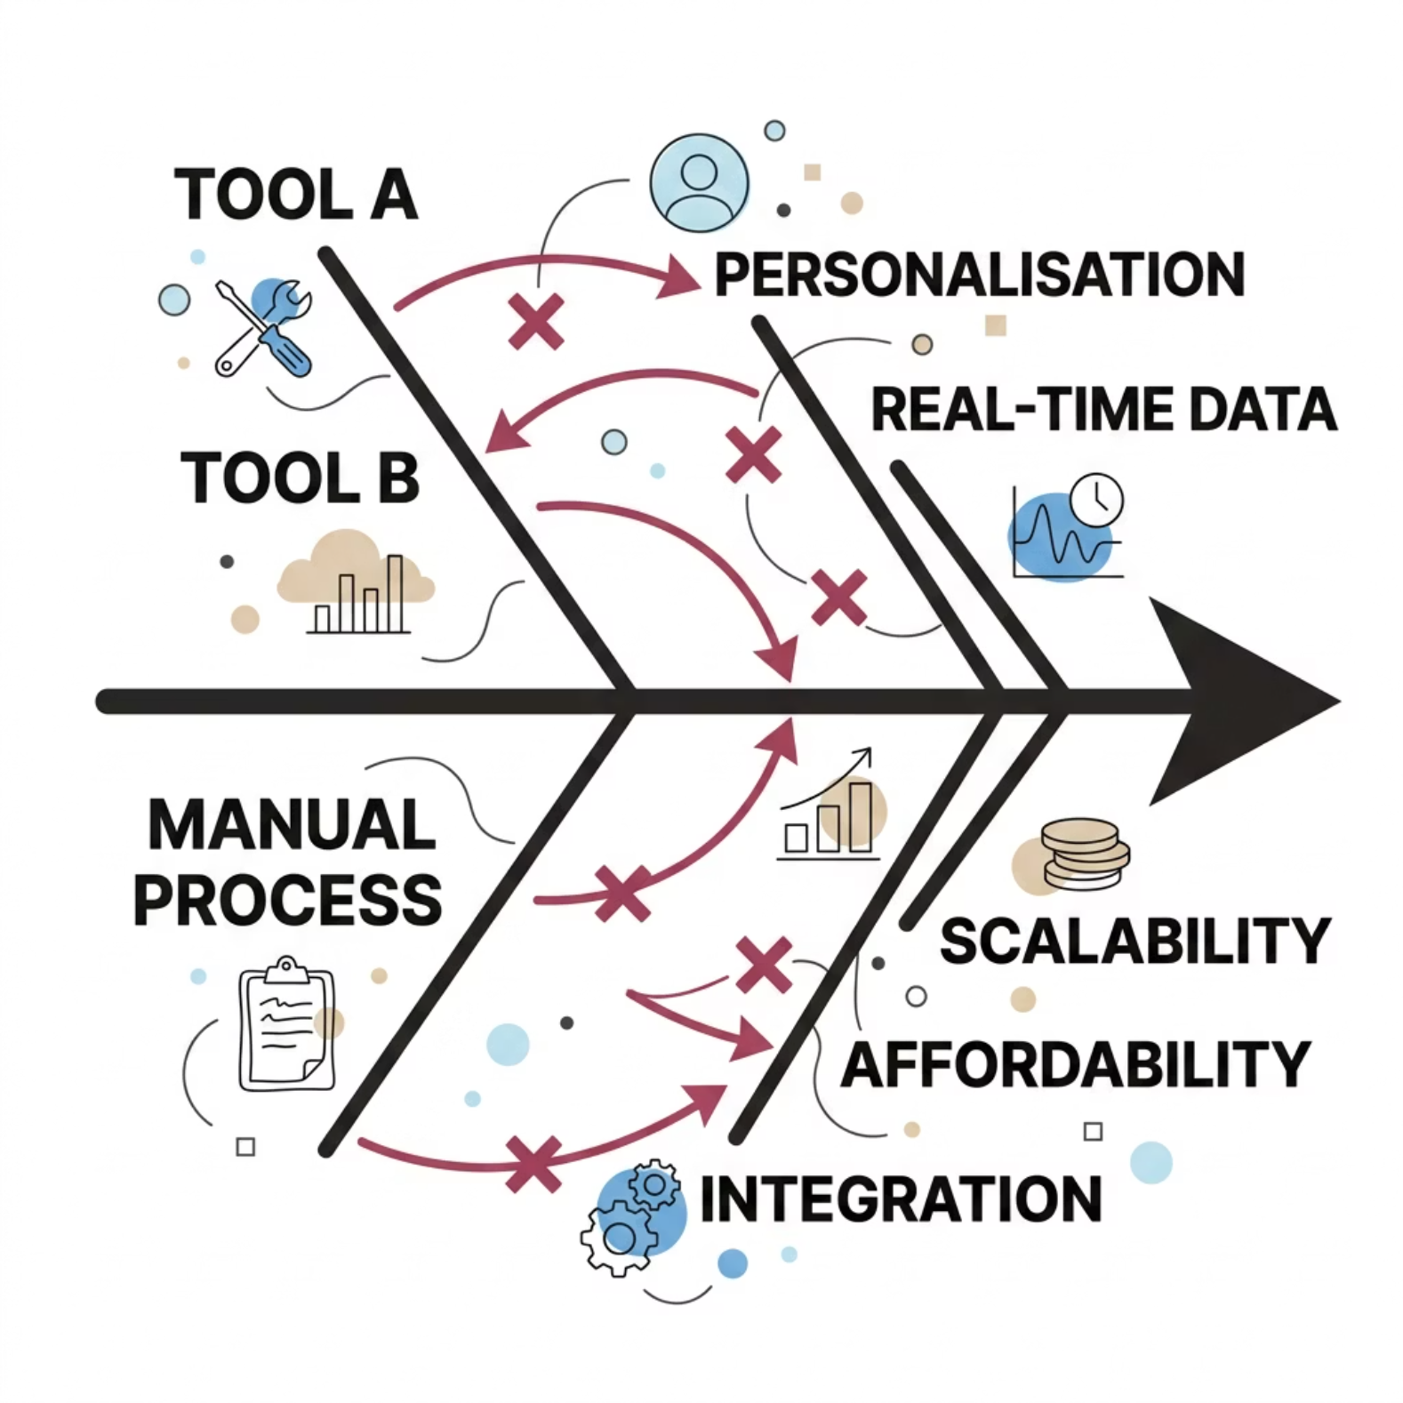
Existing Solutions & Gaps
What Exists Today
Solution Strength Gap
eBay Auctions Popular Sniping problem
Manual Auctions Flexible Slow & unfair
Online Platforms Scalable No latency control

Slide 8
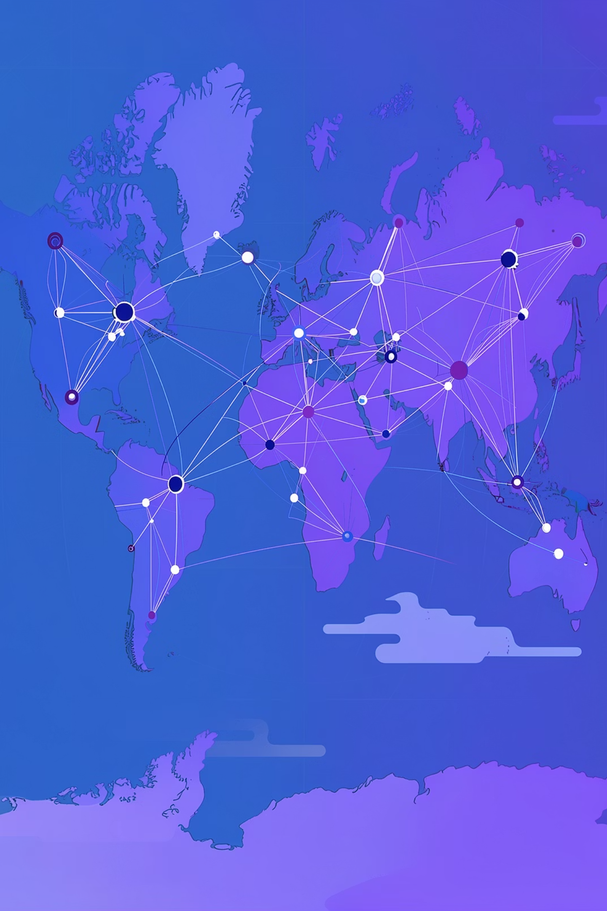

Impact of the Problem
10M+
1B$+
People Affected
Economic Loss
Estimated users facing this problem globally or regionally
Annual cost to businesses, governments, or individuals
40%
Productivity Drop
Efficiency lost due to the absence of a proper solution
If not solved → trust in digital auctions will decline

Slide 9

Objectives & Success Criteria
What the Solution Will Achieve
Key Success Metrics (KPIs)
Specific & Measurable
Achievable & Relevant
Adoption Rate
Accuracy
Ensure fair bidding regardless of internet speed
Eliminate last-second unfair advantages
10 active users in first 30 days
≥ 90% model or process precision
NPS Score
Cost Saved
Time-Bound
User satisfaction ≥ 8/10
50% reduction in unfair bids
Provide real-time synchronized auction system

Slide 10


Constraints, Assumptions & Future Scope
⚙️ Technical Constraints
⏱️ Resource Limitations
Real-time bid synchronization under varying network latency Firebase free-tier limitations
Developed within 24-hour hackathon time frame
Small team (3–4 members) managing frontend + backend
Limited access to paid APIs / cloud scaling tools
🔭 Future Scope
AI-based fraud detection for suspicious bidding patterns Blockchain-based transparent bid audit system Multi-region deployment for global latency balancing Integration with e-commerce & auction platforms Advanced analytics dashboard with predictive pricing insights
Thank you for your time! We welcome your questions, feedback, and mentorship. 📬 ananddharwad07@email.com
github.com/anand451/404-Crackers-fairBid· @404-Crackers

